Slide 1


Tweeting for Hillary
Li Meng, Matt Beaulieu, ML Tlachac, Yousef Fadila

Slide 2
“The more compelling campaign
is a direct result of better data
collection, analysis and smart
decision making”
-PromptCloud

Slide 3
Motivation
Social media is a means for getting political news, and initiating political discussion
Being able to interpret data with regards to the election would give a campaign manager live feedback on how their candidates actions likely impact polling
This allows them to gain an advantage by reacting accordingly to changing political climates

Slide 4

The Data
Pulled about 15.5K Tweets from the twitter streaming API
Filter based on:
Language: en
Tweets mentioning @Hillary Clinton
Can then process hashtags, mentions, and relevant words, to gain insights about the election

Slide 5
Most Frequent Words
Appearances | Word
1240 | trump
915 | hillary
113 | benghazi
346 | cant
142 | didnt
252 | doesnt
146 | poorest
117 | trumps
130 | wont
259 | pneumonia
87 | footing
192 | liar
232 | donors
541 | dont
45 | dnc
Appearances | Word
245 | thats
91 | isnt
41 | tweet
63 | ive
85 | nypd
142 | systematically
66 | whats
68 | cough
61 | hypocrisy
32 | dishonesty
103 | crooked
40 | theres
47 | stamina
66 | unfit
30 | scum

Slide 6
Types of Frequent Words
Opponent: trump, trumps
Criticism: unfit, liar, hypocrisy
Topics: bodyguards, benghazi, poorest, blackmail, pneumonia, audiobooks
Patterns: cant, doesnt, didnt, wont, dont, isnt

Slide 7
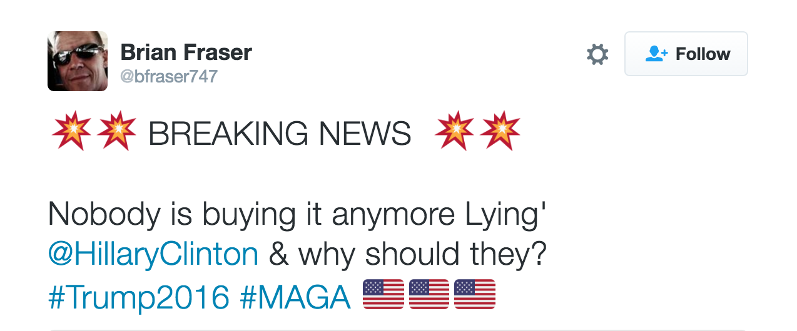
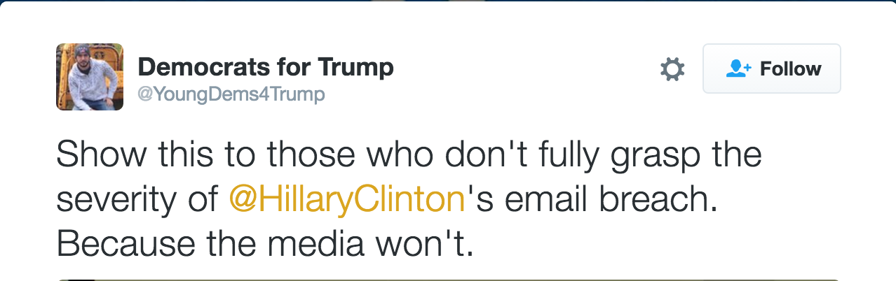

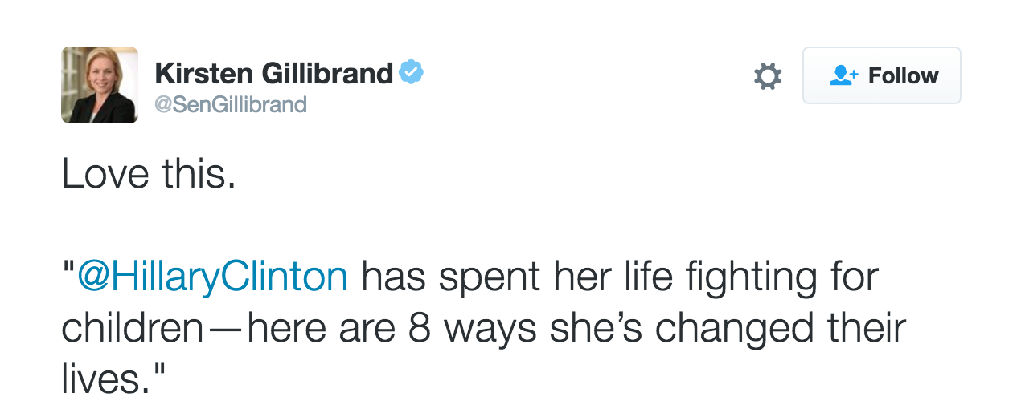
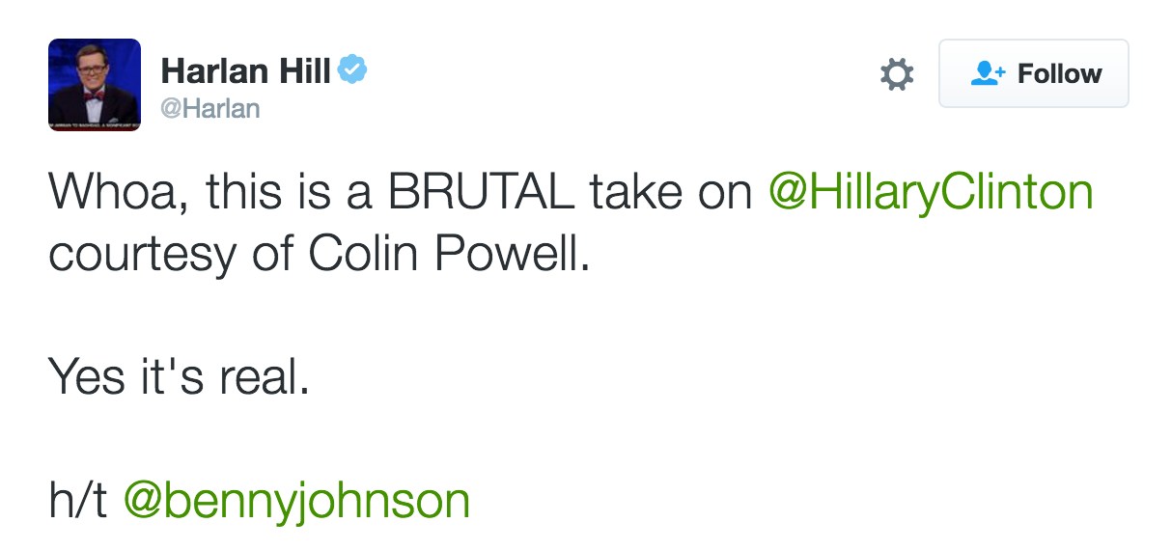
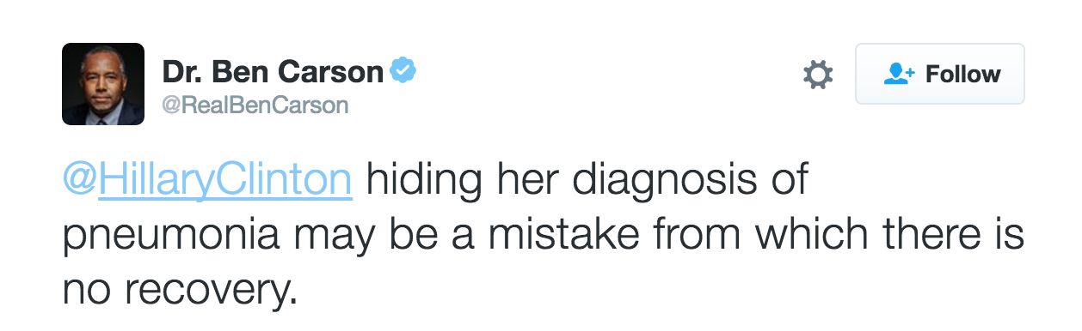
Popular Tweets

Slide 8
Entity Popularity
Popular Mentions with @HillaryClinton
Popular #hashtags with @HillaryClinton
Screen Name | Mentions
HillaryClinton | 15421
RealDonaldTrump | 2718
FoxNews | 1532
POTUS | 503
CNN | 481
politico | 283
timkaine | 263
FLOTUS | 245
MSNBC | 244
USAneedsTRUMP | 235
Hashtag | Count
#MAGA | 385
#ImWithHer | 351
#SpecialReport | 209
#NeverHillary | 178
#DNCLeak | 177
#HispanicHeritageMonth | 163
#tcot | 156
#Trump | 149
#TrumpPence16 | 125
#HillaryHealth | 102

Slide 9
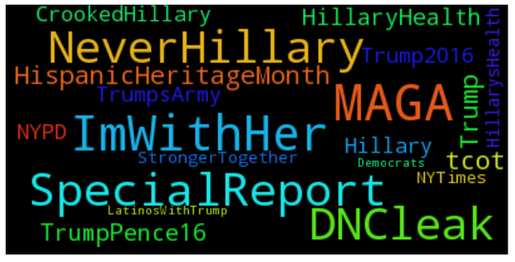

Slide 10
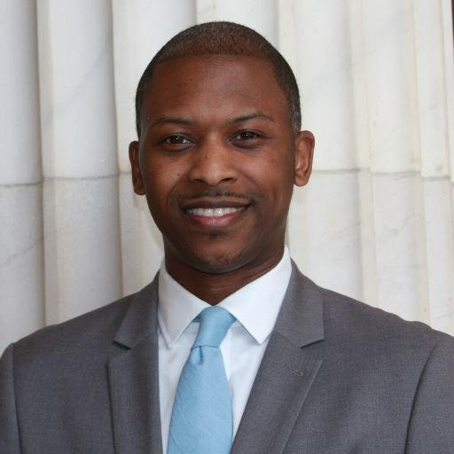
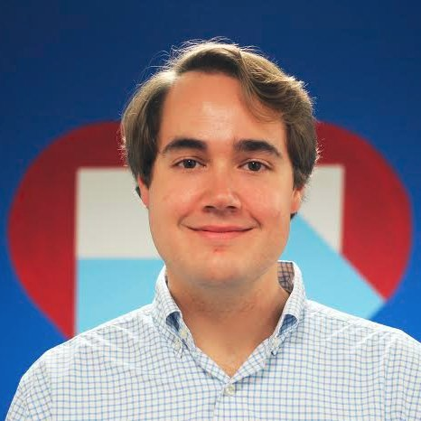


Hillary’s Friends
ID | Screen Name
571202103 | Medium
21337440 | ChildDefender
23449384 | amberdiscko
128790234 | Samynemir
1656913327 | sarajacobs89
325886383 | SammyKoppelman
802430450 | Natasha_S_Law
729761993461248000 | ktvibbs
115740215 | SarahAudelo
34782406 | Lincoln_Ross
3044781131 | HillaryforAR
113298560 | GunaRockYa
15972271 | CdotDukes
582037089 | MiguelAyala312
734768872625188864 | AndrewBatesNC
41021335 | TroyClair
4736170399 | BrianZuzenak
150885854 | SarahPeckVA
231673 | yianni
125083946 | GillDrummond
Communication Directors
Charities
Media Websites
United States Senators
etc.

Slide 11
Sentiment Analysis
Using Python’s NLTK text classifier, classified each tweet as “Positive”, “Negative”, or “Neutral”.
Could give an idea of how “twitter” felt about Hillary Clinton
Positive
Neutral
Negative

Slide 12
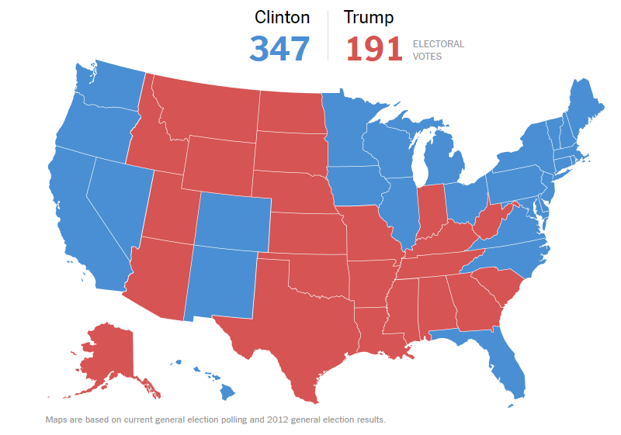
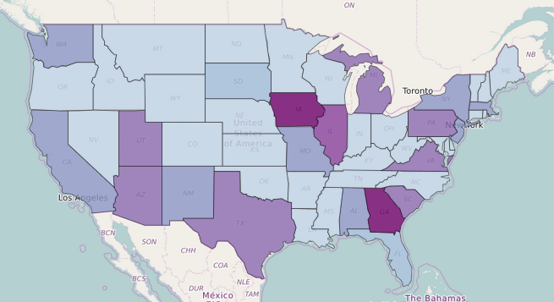

Geographic Analysis
Using the “positivity” of each tweet, we formed a ratio of positive and negative tweets, and compared it national polling data, to see how tweet hashtags related to polling data, if at all.

Slide 13
Sentiment Analysis on Text
Broke down the most popular hashtags in positive and negative tweets
Some hashtags, in either table, seemed out of place
This could be part of the source of error in the sentiment classifi
Hashtags in Positive Tweets | Count
#HispanicHeritageMonth | 118
#ImWithHer | 107
#MAGA | 72
#tcot | 65
#Democrats | 50
#RedNationRising | 46
#WakeUpAmerica | 43
#NeverHillary | 32
#HillaryClinton | 31
Hashtags in Negative Tweets | Count
#ImWithHer | 74
#LatinosWithTrump | 51
#AmericansUnitedForTrump | 49
#MAGA | 42
#NeverHillary | 39
#CrookedHillary | 38

Slide 14
Sentiment analysis on Hashtags
Manually identify positive and negative hashtags, and use this to determine popular words in tweets containing those hashtags
Positive Hashtags include...
Never Trump
Hillary2016
StrongerTogether
Vote
UnitedBlue
Negative Hashtags include...
MAGA
NeverHillary
CrookedHillary
LatinoswithTrump
AmericansUnitedwithTrump

Slide 15
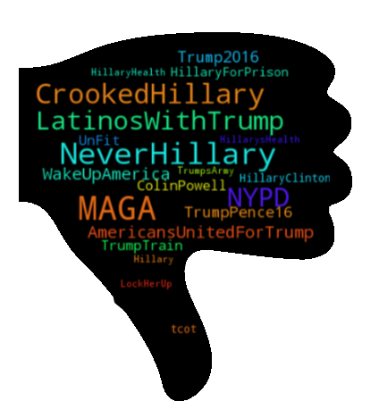
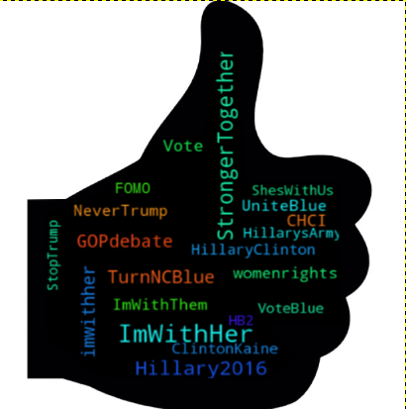

Slide 16
Conclusions
Word frequency analysis revealed relevant tweets to Clinton, and issues that she could consider addressing, or at least know what’s being talked about.
Judging tweets by positive or negative sentiment gave mixed results.
Training the positive and negative classifier on positive or negative hashtags proved more insightful.
Ultimately, 15.5K tweets is not enough data, especially when separating it by state.
Twitter has great potential to be useful to campaigns.

Slide 17
Thank You
Questions?

